Slide 1
Day 4
By
Sridhar S

Slide 2

Azure File Share
To create an Azure file share, you need to answer three questions
What are the performance requirements for your Azure file share?
What size file share do you need?
What are your redundancy requirements for your Azure file share?
Azure file shares are deployed into storage accounts, which are top-level objects that represent a shared pool of storage. This pool of storage can be used to deploy multiple file shares.

Slide 3

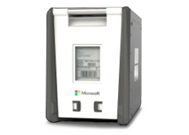
Azure Data Box
Data Box devices easily move data to Azure when busy networks aren’t an option. Move large amounts of data to Azure when you're limited by time, network availability, or costs, using common copy tools such as Robocopy.
Data Box is a ruggedized device with 100-TB capacity uses standard NAS protocols and common copy tools. It features AES 256-bit encryption for safer transit.

Slide 4
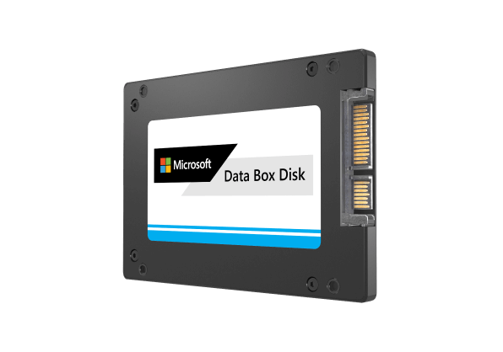
Data Box Disk
Our 8-TB SSD with a USB/SATA interface has 128-bit encryption. Customize it to your needs—it comes in packs of up to five for a total of 40 TB.

Slide 5
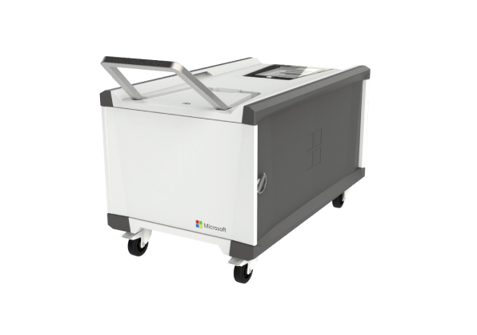
Data Box Heavy
This ruggedized, self-contained device is designed to lift 1 PB of data to the cloud.

Slide 6
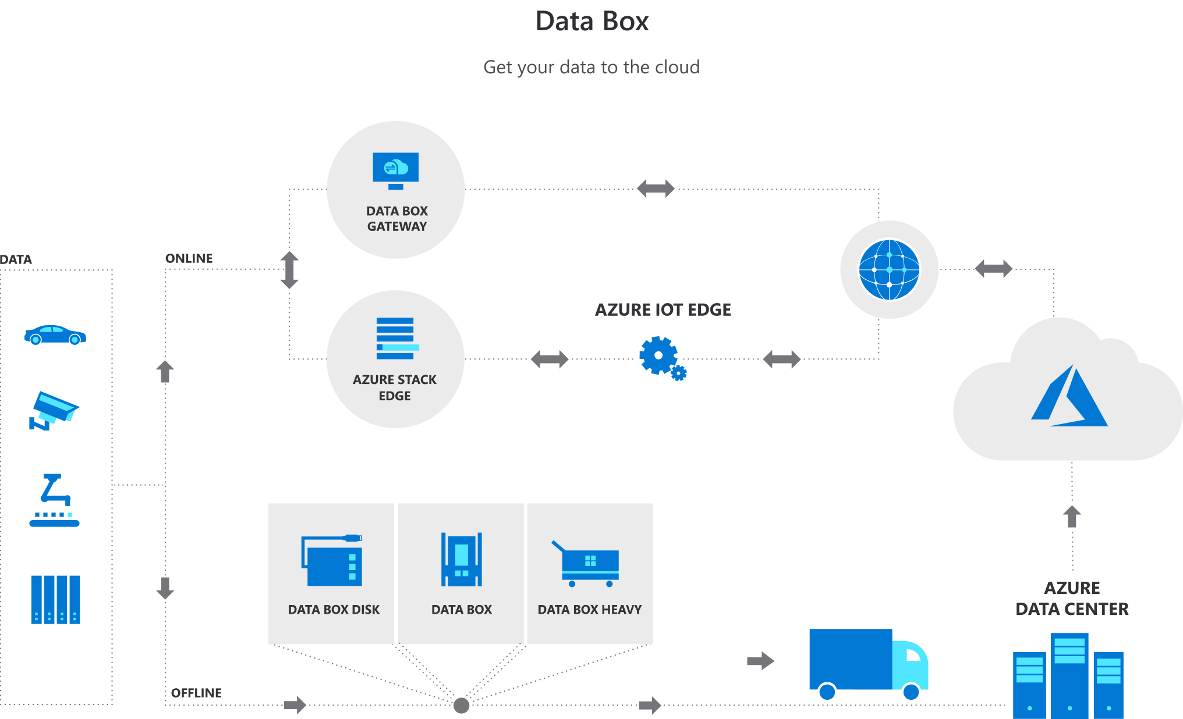
How its done

Slide 7
Azure File Sync
Use Azure File Sync to centralize your organization's file shares in Azure Files, while keeping the flexibility, performance, and compatibility of an on-premises file server.
The Azure File Sync agent enables data on a Windows Server to be synchronized with an Azure File share.

Slide 8
PowerShell Script
$location = "eastus" $resourceGroup = "teststoragerg" New-AzResourceGroup -Name $resourceGroup -Location $location
$storageAccountName = "testpshstorage" $skuName = "Standard_LRS“
$storageAccount = New-AzStorageAccount -ResourceGroupName $resourceGroup ` -Name $storageAccountName ` -Location $location ` -SkuName $skuName
Remove-AzStorageAccount -ResourceGroup $resourceGroup -AccountName $storageAccountName

Slide 9
Azure Backup
Azure Backup is simple because it is built into the platform. It has one-click backup support for SQL database and virtual machines running in Azure. Azure Backup is cost-effective and less complex than other cloud backup solutions while keeping your data safe from ransomware and human errors.
A Recovery Services vault is a logical container that stores the backup data for each protected resource, such as Azure VMs. When the backup job for a protected resource runs, it creates a recovery point inside the Recovery Services vault.
You can start a backup now rather than wait for the default policy to run the job at the scheduled time. This first backup job creates a full recovery point.

